Slide 1
Leveraging Blockchain technology for Insurance KYC and claims processing.
By-
Group No. 14
TE-IT
Guide- Sumedha Sirsikar

Slide 2
What is blockchain ?
A blockchain is a continuously growing list of records, called blocks, which are linked and secured using cryptography. Each block typically contains a cryptographic hash of the previous block, a timestamp and transaction data. By design, a blockchain is inherently resistant to modification of the data. It is "an open, distributed ledger that can record transactions between two parties efficiently and in a verifiable and permanent way". For use as a distributed ledger, a blockchain is typically managed by a peer-to-peer network collectively adhering to a protocol for validating new blocks. Once recorded, the data in any given block cannot be altered retroactively without the alteration of all subsequent blocks, which requires collusion of the network majority.

Slide 3
Description
The government would create a network of hospitals.
A person who wishes to buy health insurance can go to any one of the hospitals and get a health check-up.
His medical records would then be added on the blockchain network
Person can go to any insurance provider.

Slide 4
Continued
Policy details will be uploaded by the insurance provider on the blockchain network
In case of death of an insured person, any hospital on the network will verify the death and post the death certificate on the blockchain network.
Alert will go out to all the insurance providers

Slide 5
Objectives
To leverage blockchain technology to create an efficient and streamlined healthcare system.
To cut down on middlemen and intermediaries present in the ecosystem due to lack of trust among parties.
To introduce transparency between insurance provider and buyer.
To make basic healthcare accessible to all people.

Slide 6
Trigger based Smart Contracts
By - Sumit Hotchandani
TE-IT
Group No. 14
306051

Slide 7
Aim
“Smart Contracts”, in their purest form, seek to leverage the trustless immutable nature of the blockchain to empower peer-to-peer, dis-intermediated agreements enforced automatically by code. Smart contracts, as such, are not legal contracts, but rather, code to allow systems to execute a legal contract.

Slide 8
Objectives
To study trigger based smart contracts used in Blockchain
Advantages over existing legal contracts.
Using smart contracts to eliminate intermediaries.

Slide 9
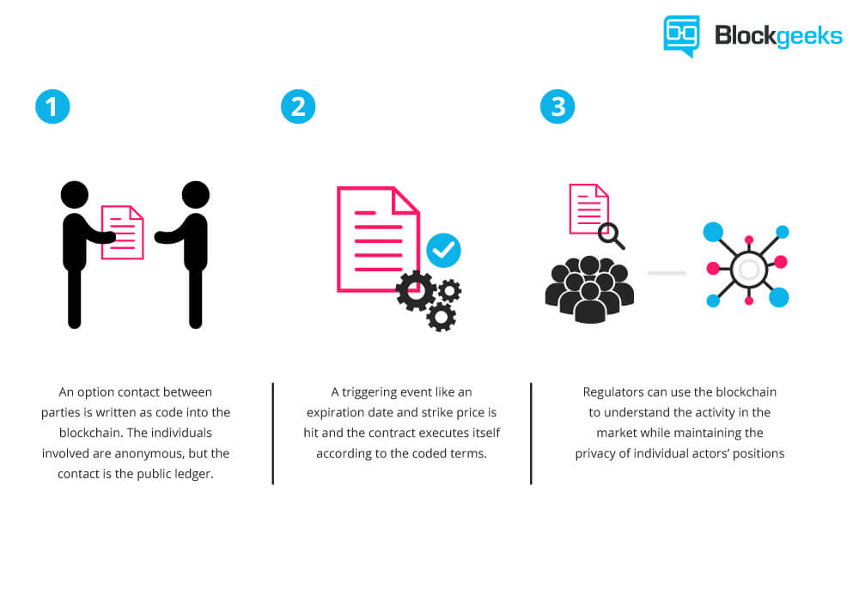
Smart Contracts in Blockchain

Slide 10
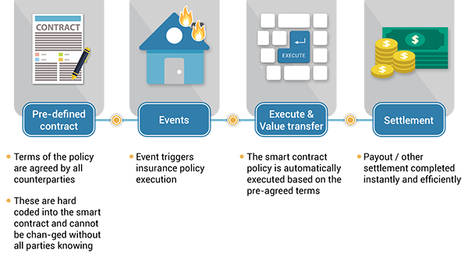
Use Case

Slide 11
Smart Contracts in Insurance
Smart contracts can be most useful in the cases when the claims process takes a significant amount of time, which is a typical problem with insurance policies, for example. The work involves many manual operations and requires a lot of human action.
For a customer, such state of affairs leads to additional costs. Insurance policies can be automated with ease with the use of smart contracts. The Blockchain can contain measurable parameters.
When there’s an insured event, the input conditions of a smart contract will be changed accordingly. As a result, the claims process will be triggered immediately, and the financial payout can be delivered to a customer without any delays. The need of human-driven intervention is reduced which allows reducing costs.

Slide 12
Conclusion
Thanks to decentralized nature of the blockchain technology, smart contracts allow participants to achieve an agreement without involving any intermediaries. In the case of dispute, there’s no need to pay a fee to a bank or lawyer. The terms of a smart contract are written with the computer code, so it can’t be misinterpreted.

Slide 13
References
C. Wright and A. Serguieva, “Sustainable blockchain-enabled services: Distributed scalability and agent-based automation,” in Applications of Data-Centric Science to Social Design, A.-H. Sato, Ed., Agent-Based Social Systems Series, H. Deguchi, Ed.-in-chief, Springer, 2018, forthcoming.
D. Magazzeni, P. McBurney and W. Nash, “Validation and Verification of Smart Contracts: A Research Agenda,” Computer, vol. 50(9), pp. 50-57, 2017.

Slide 14
Continued
Legally Speaking: Smart Contracts, Archival Bonds, and Linked Data in the Blockchain .
Darra L. Hofman School of Library, Archival, and Information Science The University of British Columbia Vancouver, British Columbia, Canada
A Next Generation Smart Contract & Decentralized Application Platform
By Vitalik Buterin

